Slide 1

Bonding: Metallic bonding

Slide 2
Introduction to Bonding
Chemical bond: a mutual electrostatic attraction between the nuclei and valence electrons of different atoms that bind the atoms together
Why form chemical bonds?
Decrease potential energy
Increase stability
All atoms trying to achieve a stable octet

Slide 3
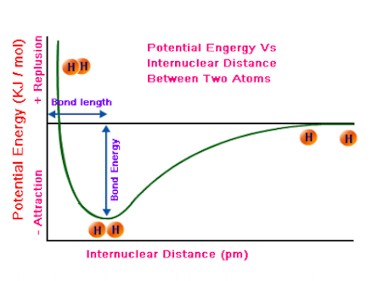
Potential energy of bonding
Potential energy diagram of bonding:
Note: this is a covalent bond example

Slide 4
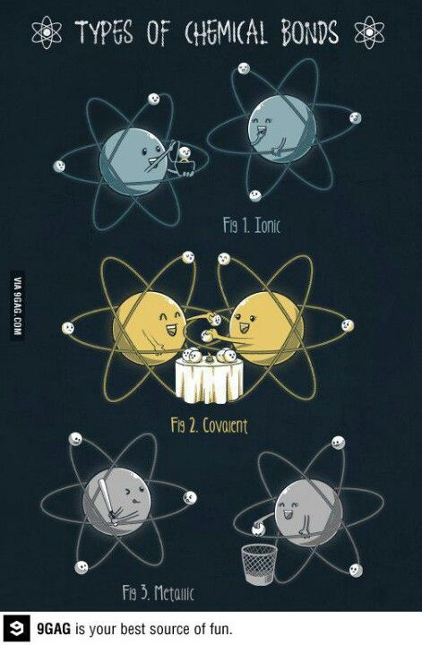
Types of chemical bonding
When atoms bond, their valence electrons are moved around in ways that make the atoms more stable
The way their valence electrons move around determine the type of bond that happens
Three major types of chemical bonding:
Metallic
Ionic
Covalent – molecular and network

Slide 5
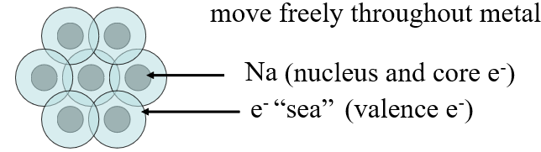
Metallic bonding
Metallic bonding: the chemical bonding that results from the attraction between metal atoms and the surrounding sea of electrons (the sea of electrons model)
Within metals, vacant orbitals allow the atoms’ outer energy levels to overlap
Result = electrons become delocalised
Delocalisation: not belonging to any one atom, but freely move around the metal’s network of empty atomic orbitals

Slide 6
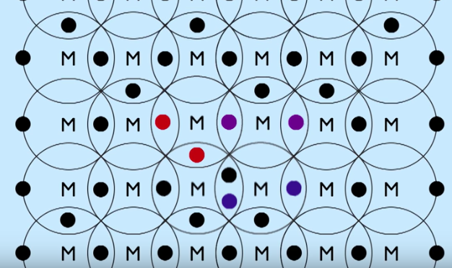
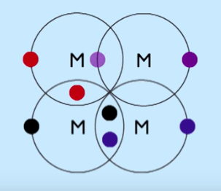

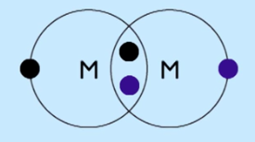
Metallic bonding

Slide 7


Slide 8
Metallic properties
What are the properties of metals that you already know?
30 s to think for yourself – 30 s to discuss with your neighbour
– people asked at random

Slide 9
Metallic properties
Conduct electricity
Conduct heat
Malleable
Ductile
Shiny appearance
High melting point
Extremely high boiling point

Slide 10
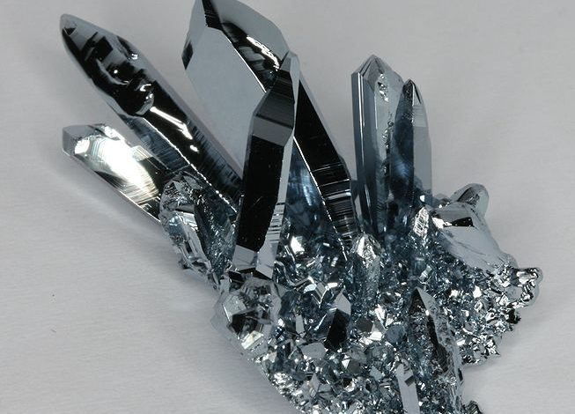
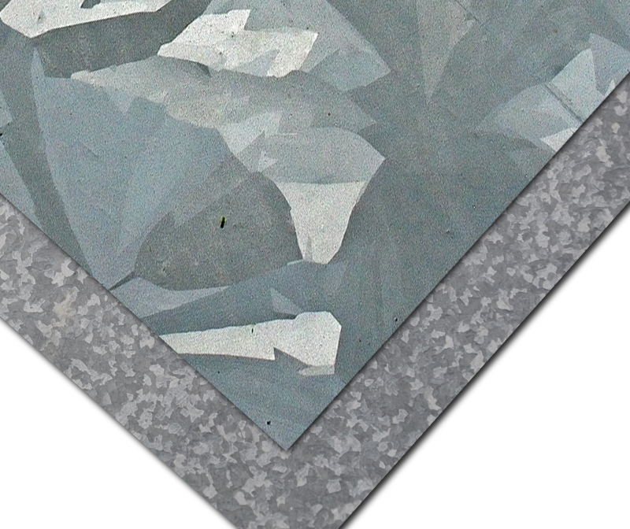
Metallic properties
High density:
metal ions form a lattice which is more tightly packed than the lattice in ionic compounds
Form crystals called grains
Crystals of osmium
Galvanised steel

Slide 11
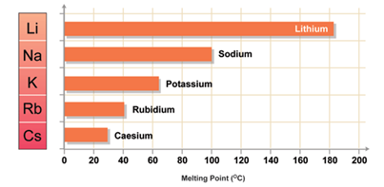
Metallic properties
High melting point and boiling point:
Metallic bonds are very strong, require a lot of energy to break them
Which metal has the lowest melting point?
Explain this trend:

Slide 12

Why metals are malleable

Slide 13
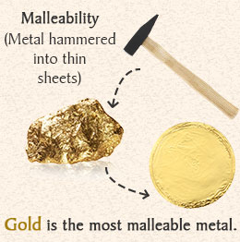
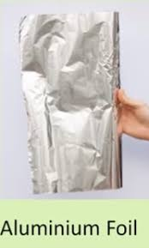
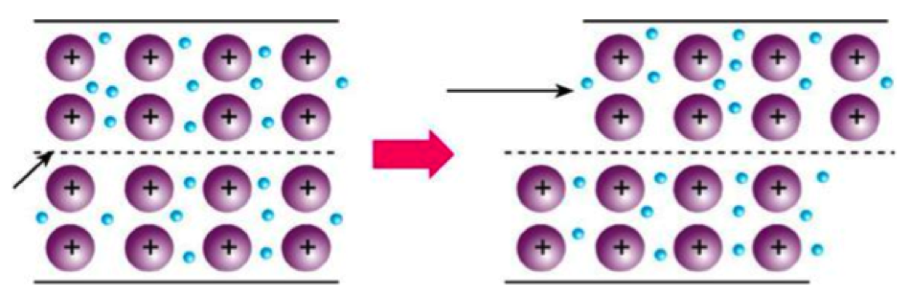
Metallic properties
Metals are malleable:
the ability of a substance to be hammered or beaten into thin sheets
Metallic bonds are non-directional, so it is possible to slide layers of cations over each other while maintaining the bonding.

Slide 14
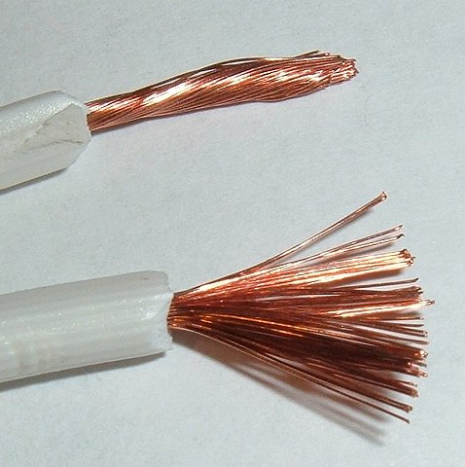
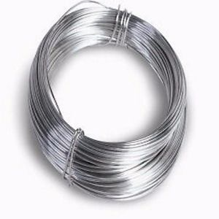
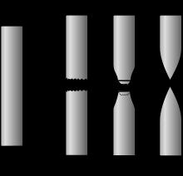
Metallic properties
Metals are ductile:
the ability of a substance to be drawn, pulled or extruded through a small opening to produce a wire.

Slide 15
Metallic properties
Metals conduct electricity and heat:
Heat – free electrons can take heat energy, which makes them move faster. They can then transfer this energy throughout the lattice.
Electricity – free electrons can carry an electrical charge

Slide 16
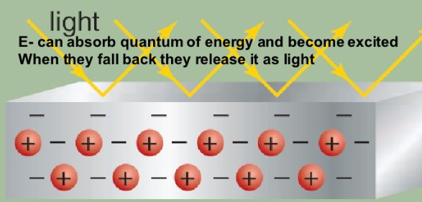
Metallic properties
Metals are shiny:
De-excitation responsible for the shiny appearance of metal surfaces

Slide 17
Metallic properties
High electrical and heat conductivity due to the freedom of electrons to move in a network of metals
High melting point (exception is mercury)
De-excitation responsible for the shiny appearance of metal surfaces
Malleability: the ability of a substance to be hammered or beaten into thin sheets
Ductility: ability of a substance to be drawn, pulled or extruded through a small opening to produce a wire
Characteristic possible because metallic bonding is the same in all directions throughout the solid

Slide 18
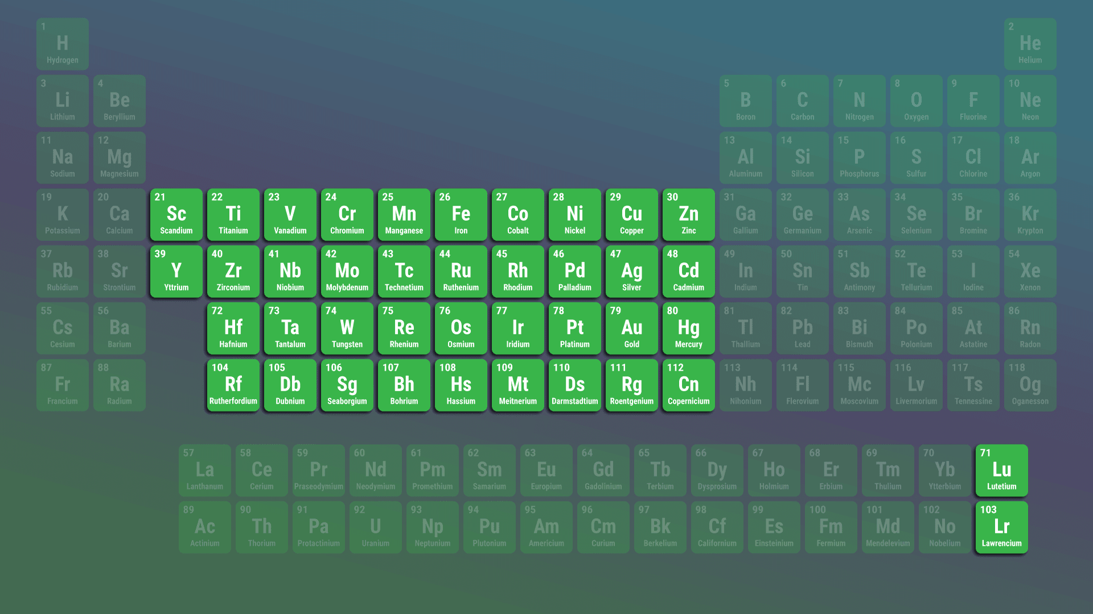
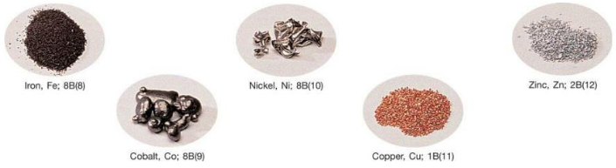
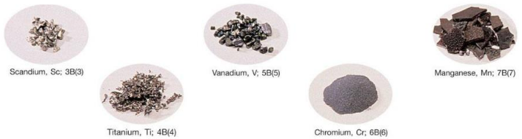
Transition metal properties
Compared to main group metals they tend to:
Be harder
Have higher densities
Have higher melting points
Some have stronger magnetic properties
This is due to TM generally being smaller is size due to their great effective nuclear charge. This allows them to pack closer together with stronger bonds

Slide 19
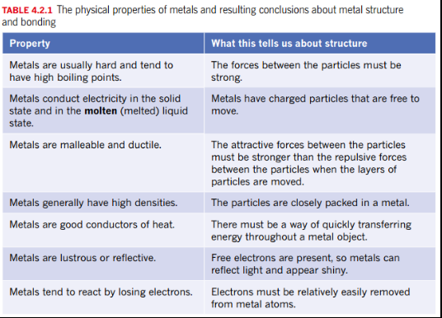
Metallic bonding summary

Slide 20
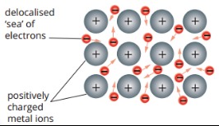
Metallic bonding summary
Metallic bonding model must have:
Charged particles are free to move and conduct electricity
Strong forces of attraction between atoms throughout the structure
Some electrons are relatively easy to remove

Slide 21
Metallic bonding summary
Structure of a solid sample of a metal
Positive ions closely packed in a lattice. The cations occupy fixed positions in the lattice.
Negatively charged electrons move freely throughout the lattice, they are called delocalised electrons.
Delocalised electrons come from the valence shells of the atoms. Core electrons are not free to move.
Positive cations are held in the lattice by electrostatic force of attraction between the cations and delocalised electrons. This attraction extends throughout the lattice and is called metallic bonding

Slide 22
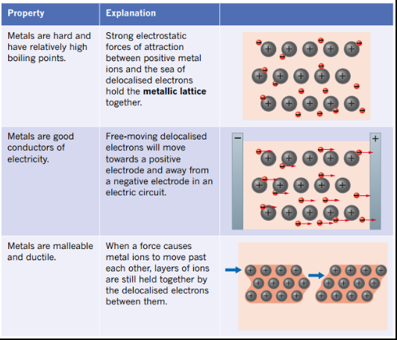
Metallic bonding summary

Slide 23
Limitations of the model
The metallic bonding model allows us to explain the general trends in metallic properties that we observe.
It cannot easily account for:
All variation in properties, e.g. why is mercury a liquid at room temperature?
Differences in electrical conductivity
Magnetic nature of some but not all metals

Slide 24
On going work
Pearson Chapter 4.1 and 4.2 plus key question sections
Pearson chapter 4 review questions 1 – 11
Don’t need to do chapter 4.3 metal reactivity at this time.
Next lesson – modifying metals: alloys and nanoparticles

